Slide 1

Computer Graphics
Dr. Lucy J. Gudino
Computer Science & Information Systems Group
Birla Institute of Technology & Science, Pilani, Goa Campus

Slide 2
Introduction to OpenGL

Slide 3
What is OpenGL?
OpenGL is a software interface to graphics hardware introduced in 1992
  OpenGL is the premier environment for developing portable, interactive 2D and 3D graphics applications
  hardware independent
    same code for NVIDIA, ATI,…
  platform independent
    same code for linux, mac, windows,…
> 700 distinct commands
  to produce interactive graphics
  → http://www.opengl.org/
Notes:
NVIDIA is a world leader in visual computing technology, inventor of GPU (graphics processing unit). The term GPU was popularized by NVIDIA in 1999, who marketed the GeForce 256 as "the world's first 'GPU', or Graphics Processing Unit, a single-chip processor with integrated transform, lighting, triangle setup/clipping, and rendering engines that is capable of processing a minimum of 10 million polygons per second". Rival ATI Technology coined the term visual processing unit or VPU with the release of the Radeon in 2002.

Slide 4
Contd…
no commands for
  creating and managing windows
  dealing with user input (mouse, keyboard,…)
no high-level commands for
  describing 3D objects
  only small set of geometric primitives
    points, lines, polygons,…
The OpenGL Utility Toolkit (GLUT) is a library of utilities for OpenGL programs, which primarily perform system-level I/O with the host operating system.
The OpenGL Utility Library (GLU) built on top of OpenGL provides modeling features
Notes:
OpenGL is designed as a streamlined, hardware-independent interface to be implemented on many different hardware platforms. To achieve these qualities, no commands for performing windowing tasks or obtaining user input are included in OpenGL; instead, you must work through whatever windowing system controls the particular hardware you’re using.
The OpenGL Utility Library (GLU) built on top of OpenGL, provides many of the
modeling features, such as quadric surfaces and NURBS curves and surfaces.
The OpenGL Utility Toolkit (GLUT) is a library of utilities for OpenGL programs, which primarily perform system-level I/O with the host operating system. Functions performed include window definition, window control, and monitoring of keyboard and mouse input. Routines for drawing a number of geometric primitives (both in solid and wireframe mode) are also provided, including cubes, spheres and the Utah teapot. GLUT also has some limited support for creating pop-up menus.
GLU is a standard part of every OpenGL implementation
The OpenGL Utility Library (GLU) built on top of OpenGL, provides many of the modeling features, such as quadric surfaces and NURBS curves and surfaces. GLU is a standard part of every OpenGL implementation

Slide 5
Developer-Driven Advantages
Industry standard
  An independent consortium, the OpenGL Architecture Review Board, guides the OpenGL specification.
  Has broad industry support,
  OpenGL is the only truly open, vendor-neutral, multiplatform graphics standard.

Slide 6
Developer-Driven Advantages
Stable
  Additions to the specification are well controlled, and proposed updates are announced in time for developers to adopt changes.
  Backward compatibility requirements ensure that existing applications do not become obsolete

Slide 7
Developer-Driven Advantages
Reliable and portable
  All OpenGL applications produce consistent visual display results on any OpenGL API-compliant hardware, regardless of operating system or windowing system.
Scalable
  OpenGL API-based applications can run on systems ranging from consumer electronics to PCs, workstations, and supercomputers. As a result, applications can scale to any class of machine that the developer chooses to target.

Slide 8
Developer-Driven Advantages
Easy to use
Well-documented
Support for client server protocol
  That is, the application program producing the graphics may run on a machine other than the one on which the graphics are displayed.
  The server part of OpenGL, which runs on the workstation where the graphics are displayed, can access whatever physical graphics device or frame buffer is available on that machine

Slide 9
Features in OpenGL
3D Transformations
  Rotations, scaling, translation, perspective
Colour models
  Values: R, G, B, alpha.
Lighting
  Flat shading, Gouraud shading, Phongshading
Rendering
  Texture mapping

Slide 10
Features in OpenGL…
Modeling
  non-uniform rational B-spline (NURB) curves, surfaces
Others
  atmospheric fog, alpha blending, motion blur

Slide 11
Abstractions
GLUT:
  Windowing toolkit (key, mouse handler, window events)
GLU:
  Viewing –perspective/orthographic
  Image scaling, polygon tessellation
  Sphere, cylinders, quadratic surfaces
GL :
  Primitives - points, line, polygons
  Shading and Colour
  Translation, rotation, scaling
  Viewing, Clipping, Texture
  Hidden surface removal
Notes:
A computer graphics tessellator takes one or more connected sets of points and forms a series of polygons that fill to form the described shape. In place of stone and glass, it uses triangles and pixels. A polygon tessellator is specially designed to manage the drawing of polygons that have unusual attributes such as holes

Slide 12
First Program
Write open GL code to display three Lines on the window

Slide 13

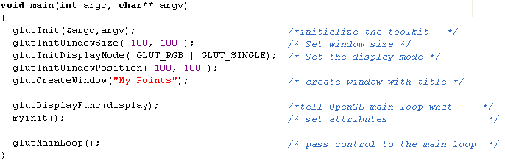

Slide 14
glutInit(&argc, argv)
  Initializes the OpenGL Utility Tool Kit
  Its arguments are the standard ones for passing information about the command line
glutInitDisplayMode ( GLUT_RGB | GLUT_SINGLE);
  Specifies how display should be initialised
  GLUT_RGB and GLUT_SINGLE are built in constants
  GLUT_RGB : colors are specified using desired amounts of red, green and blue
  GLUT_SINGLE : single display buffer should be allocated

Slide 16
glutInitWindowSize( 100, 100 );
  Specifies that the screen window should be 100 pixels by 100
glutInitWindowPosition( 100, 100 );
  specifies that the window’s upper left corner should be positioned on the screen 100 pixels from left edge and 150 pixels down from the top
glutCreateWindow("My Point");
  This function actually opens and displays the screen window, with title My Point

Slide 17
Window based programming
Event driven programming
  Program responds to various events
    Window: resize, expose, iconify
    Mouse: click one or more buttons
    Motion: move mouse
    Keyboard: press or release a key
    Idle: nonevent
      Define what should be done if no other event is in
  Event queue :
    Receives messages stating that certain events have occurred
    Manages first come first serve basis

Slide 18
Call Back functions
Need an interface for event-driven input
A callback function is defined for each type of event
This user-supplied function is executed when the event occurs
GLUT example:
glutMouseFunc(mymouse)

Slide 19
Contd…
The method of associating a callback function with a particular type of event is often quite system dependent
OpenGL Utility Toolkit provides tools to assist with event management

Slide 20
glutDisplayFunc(display)
  glutDisplayFunc sets the display callback for the current window.
  Usage
    void glutDisplayFunc(void (*func)(void));
    func: The new display callback function.
  The display callback is executed whenever GLUT determines that the window should be refreshed, for
      When the window is first opened
      When the window is reshaped
      When a window is exposed
      When the user program decides it wants to change the display

Slide 21
Contd…
glutReshapeFunc(myReshape)
  The function myReshape() is registered with the reshape event
  myReshape() is automatically passed arguments that report the new width and height of the reshaped window

Slide 22
glutMouseFunc(myMouse)
glutKeyboardFunc(myKeyboard)

Slide 23
Contd..
glutMainLoop();
  When this instruction is executed, the program draws the initial picture and enters an unending loop, in which it simply waits for events to occur

Slide 24
Header files
#include <windows.h> // to access wgl routines
#include <GL/gl.h>
#include <GL/glu.h>
OR
#include <GL/glut.h>

Slide 25
Related Libraries
OpenGL Utility (GLU)
  Provides routines for
    Describing complex objects with line and polygon approximations
    Setting up viewing and projection matrices
    Displaying B-splines using linear approximations
  GLU functions starts with prefix glu
    gluLookAt(), gluPerspective() …
Display windows cannot be directly created using basic OpenGL functions
  Since OpenGL library contains device independent functions
  Window management functions system dependent

Slide 26
Contd…
GLX : OpenGL Extension to the X window system
  Routines are prefixed by glx
AGL: Apple GL
  Routines are prefixed by agl
WGL: (microsoft) windows to OpenGL
  Routines are prefixed by wgl
PGL: Presentation Manager to openGL
  Interface to IBM OS/2
  Routines are prefixed by pgl

Slide 27
Contd…
GLUT: OpenGL Utility Toolkit provides a library functions for interfacing with any screen windowing function
  Routines are prefixed by glut

Slide 28
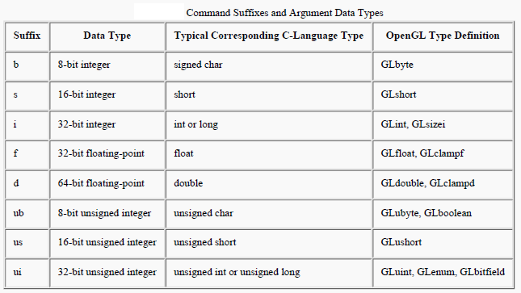
Contd…
Extra letters in some commands indicate the number and type of variables
  glColor3f(), glVertex3f() …
OpenGL data types

Slide 29
OpenGL function format
function name
dimensions
glVertex3f(x,y,z)
x,y,z are floats
belongs to GL library
glVertex3fv(p)
p is a pointer to an array

Slide 30
Contd…
Function arguments within the function be assigned a symbolic constant specifying
    Parameter name, a value for a parameter or a particular mode
    Constants begin with GL
    Component words within a constant name are written in capital letters and separated by _
    Examples: GL_COLOR_BUFFER_BIT, GL_PROJECTION, GL_MODELVIEW …

Slide 31
Points, lines and polygons
glBegin(mode) and glEnd( ) delimit an object
mode can be one of the following:
  – GL_POINTS
  – GL_LINES
  – GL_POLYGON
  – GL_LINE_STRIP
  – GL_TRIANGLE_STRIP
  – GL_TRIANGLES
  – GL_QUADS
  – GL_LINE_LOOP
  – GL_QUAD_STRIP
  – GL_TRIANGLE_FAN

Slide 32
OpenGL Point Functions
  glBegin ( GL_POINTS );
  glVertex2i (180,20);
  glVertex2i (280,20);
  glEnd ();
  Data types:
    i→ integer
    s→short
    f→float
    d→double

Slide 33
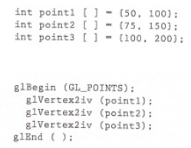
Contd..
v specifies pointer to an array

Slide 34

Contd…
Points in three dimensional reference frame

